Slide 1
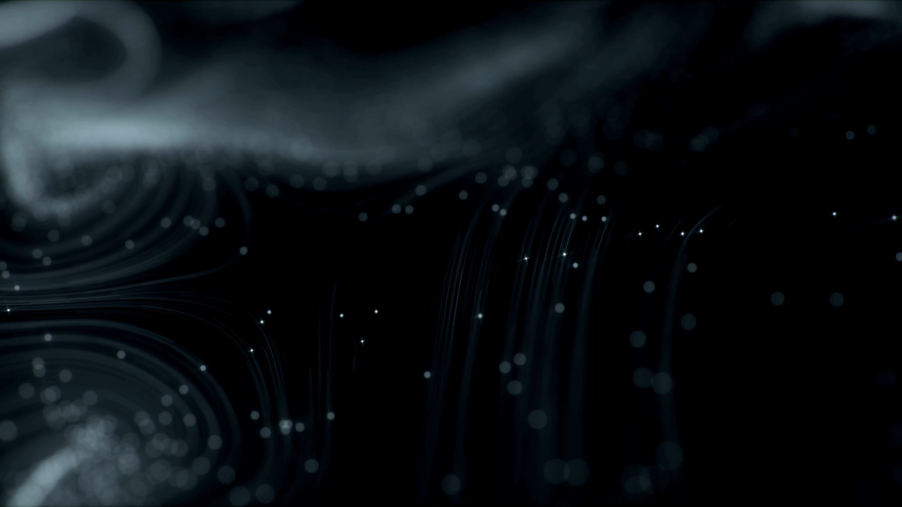
Neural Style Transfer: An Implementation Using VGG19
Sheheryar Sohail (03-134211-040)
Murtaza Anwaar (03-134211-032)

Slide 2
Introduction
Explanation of neural style transfer
Importance of blending content and style in images
Brief overview of the project's objectives

Slide 3
Literature Review
Summary of key research in neural style transfer
Introduction to VGG19 as a common architecture for style transfer
Discussion on the evolution of techniques and models in the field

Slide 4
Methodology
Dataset selection and preprocessing
Model architecture: VGG19 and its layers
Explanation of loss functions: content loss, style loss, total loss
Optimization process using Adam optimizer

Slide 5
Experiments & Results
Evaluation measures: content loss, style loss, total loss
Explanation of hyperparameters used in the project
Presentation of results: final generated image and loss values
Visual comparison between content, style, and generated image

Slide 6
Discussion
Comparison with state-of-the-art models and techniques
Highlighting the strengths and limitations of VGG19-based style transfer
Potential applications and future research directions

Slide 7
Thank You

